Slide 1
HACCP
(Hazard Analysis Critical Control Point)
Training
Notes:
TELL: Hello and good morning or (afternoon), my name is _______ : Welcome to the HACCP Training. First I want to ask why are we here today? What are your expectations from this training?
My goal is for you to become knowledgeable about HACCP. You will understand the process on how to handle, prepare, hold and serve safe food to our guests.

Slide 2
Overview
HACCP plans are designed to provide safe, quality food to customers by identifying hazards and determining preventive measures throughout the flow of food.
Notes:
TELL: HACCP plans are designed to provide safe, quality food to customers by identifying hazards, and determining preventive measures throughout the flow of food. The Food and Drug Administration, known as the FDA, estimates that between approximately 24 to 81 million people have gotten ill from eating contaminated food. Each year, approximately 5000 deaths have been recorded in the United States.
Next Slide

Slide 3
Purpose And Benefits
The primary purpose of a HACCP system is to protect people from food borne illness, but the benefits of the system also extend to the company.
Reduction in product loss
Increase in product quality
Better inventory control
Consistency in product preparation
Increase in revenue
Notes:
TELL: The primary purpose of a HACCP system is to protect people from food borne illness. The benefits of having a HACCP system also extend to the company by increased confidence in products which will reduced liability and add an effective process management. This will also improve quality as well as continually have consistence products.
Next Slide

Slide 4
Objectives
This training will provide the knowledge of food safety by understanding how to utilize the HACCP plan.
The flow of food
Food safety management
HACCP plan
The seven HACCP principles
Record keeping requirements
Notes:
Tell: This training will provide you with the knowledge of food safety management by using the HACCP system and procedures that are in place. You will learn and understand how to eliminate, prevent, and reduce hazards during the flow of food. You will learn about the Seven HACCP Principles and how they apply to your facility. This training will teach you why Record Keeping is an important part of food safety.
Next Slide

Slide 5
HACCP Background
HACCP was conceived in the 1960’s by Pillsbury to design and manufacture the first foods for space flights.
During their long dangerous journey, NASA wanted to ensure the crew will not get a food borne illness. NASA asked Pillsbury to develop the program and HACCP was born.

Slide 6
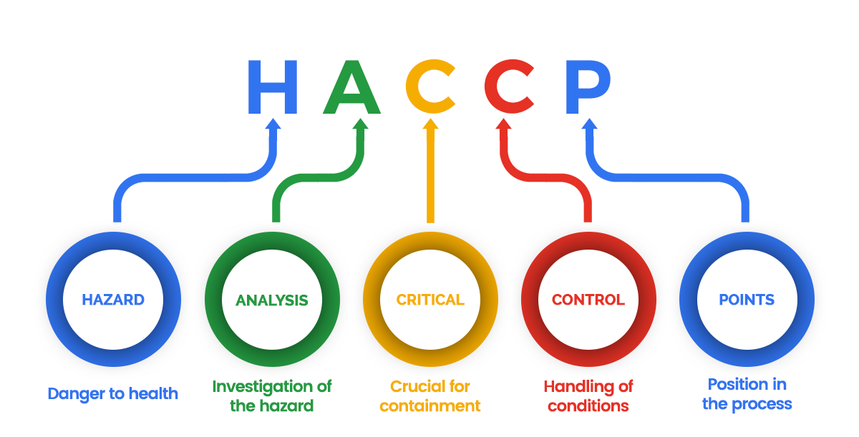
What is HACCP?
HACCP is an acronym which stands for
It is a food safety management system that effectively prevents hazards throughout the flow of food.
Notes:
TELL: The Hazard Analysis Critical Control Point (HACCP) system is a logical, scientific system that controls safety problems in food production. HACCP is a risk management system that identifies, evaluates, and control hazards through the flow of food, it works with any type of food production system.
Next Slide

Slide 7
Types of Hazards
Chemical Hazards
Cleaning agents
Physical Hazards
Metal can shavings
Biological Hazards
Personal cleanliness
Detergents
Cross contamination
Coughing, sneezing, and infected wounds
Sanitizers
Jewelry
Hair, Beards, Nails and Eye Lashes
Notes:
Engage your audience. Select and allow managers to provide an example of each hazards

Slide 8
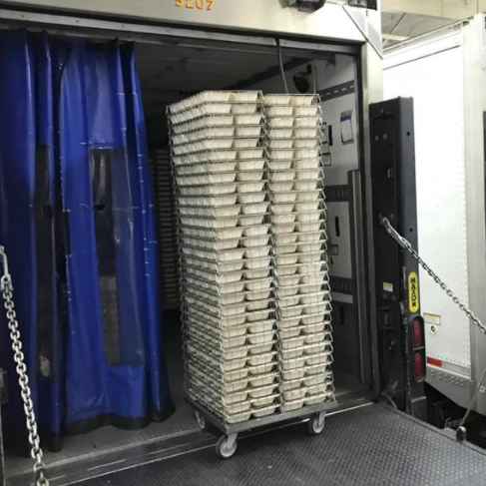
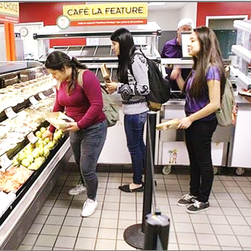
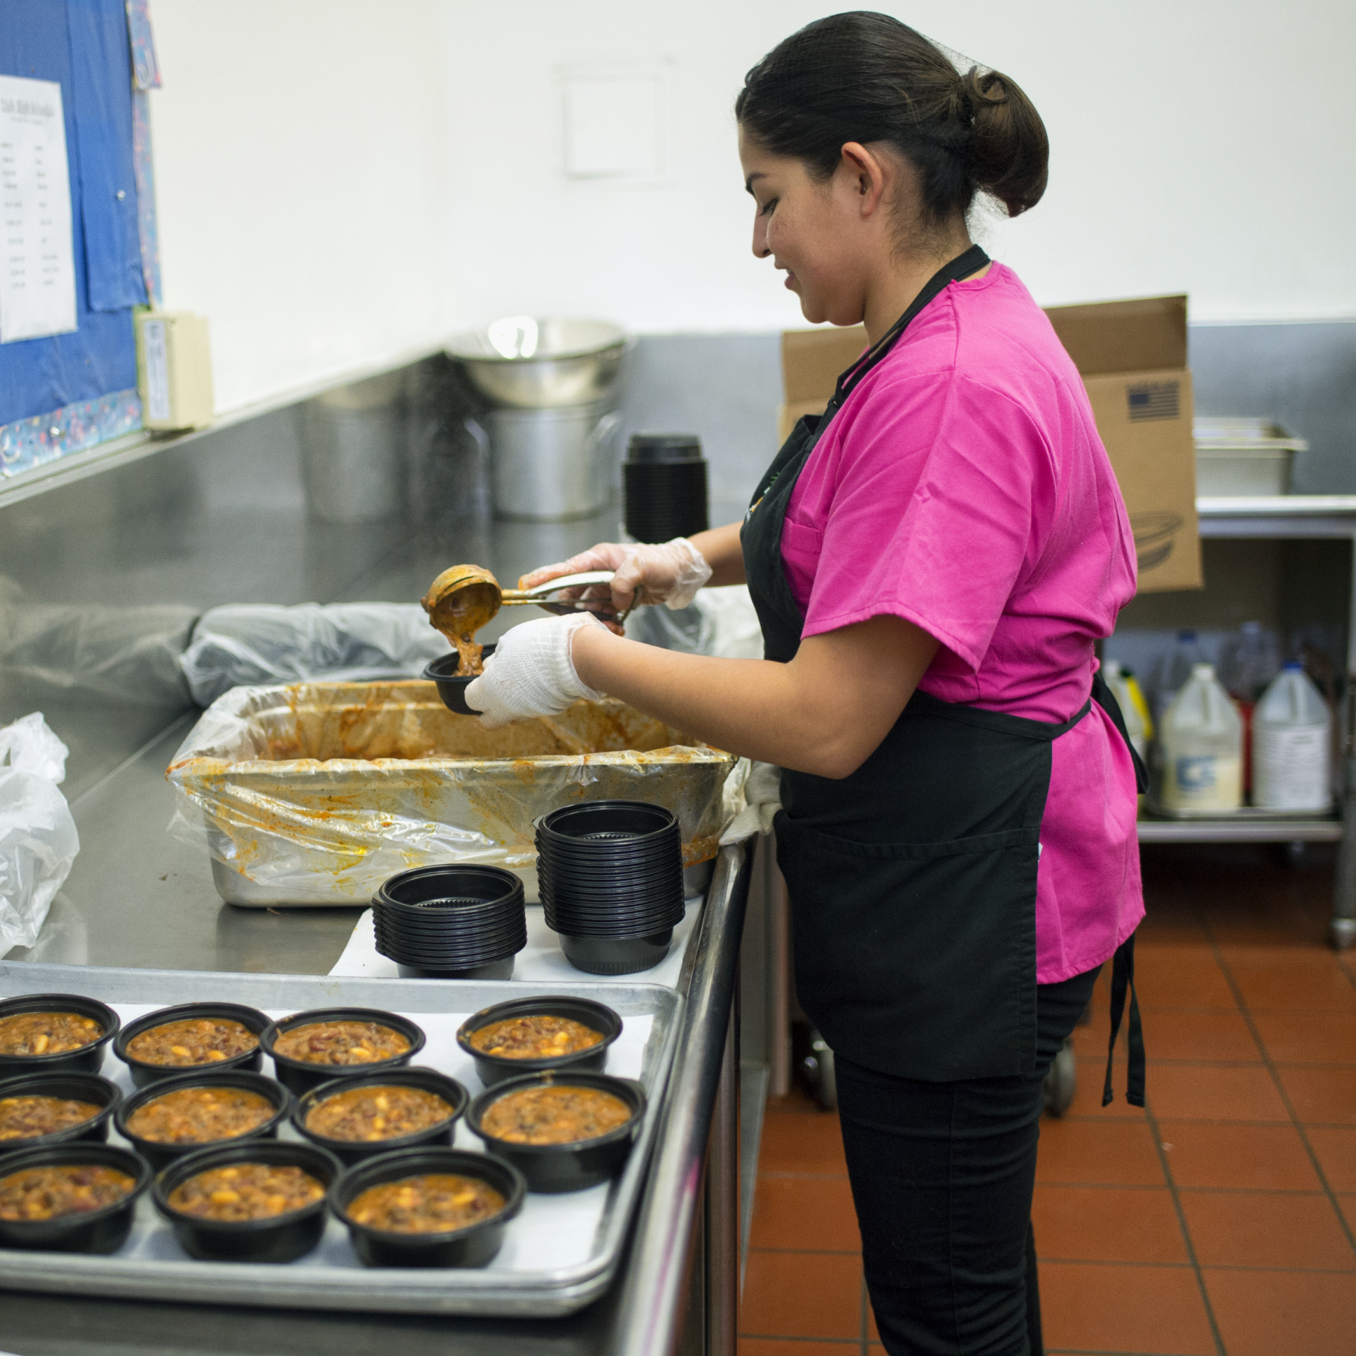
Flow Of Food: The Path of Food
Purchasing
Receiving
Storing
Holding
Serving
Cooking/Prepping
Notes:
TELL: The Flow of Food describes what happens to food from the time it enters your workplace until it is served to customers. The flow begins with purchasing from our vendors and continues with receiving, storing, preparation/assembly, holding, and serving the food to your customers. Throughout every step of the process the HACCP system must be followed.
Next Slide

Slide 9
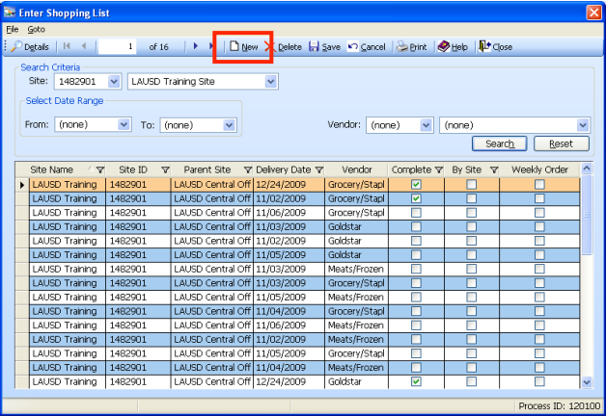
Purchasing
General Purchasing Principles
Purchase food from approved, reputable suppliers:
Have been inspected
Meet all applicable local, state and federal laws
Notes:
TELL: The Food Services Division purchases food from reputable suppliers who receive their products from approved sources that have been inspected and are in compliance with local, state and federal laws according to the California Food Code 3-201.11. The California food code also states that no food from home may be stored in the refrigerated holding units or served to customers.
Next Slide

Slide 10
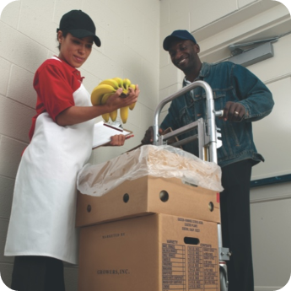
Receiving
Manager will inspect all packages for quality:
Check frozen foods to ensure that they are all solid
Inspect deliveries for signs of time-temperature abuse or contamination
Store items promptly after receiving
Notes:
TELL: Even though Federal and State agencies regulate and monitor the production and transportation of food, it is your responsibility to check the food that is delivered to your facility. FSD staff should inspect shipments for intact packaging, dented cans, signs of refreezing, prior wetness, and pest infestation. The receiver must use an infrared thermometer to take the temperature of cold, frozen food, and record the temperature of the food on the receiving invoices. All shipments showing signs of time/temperature abuse should be rejected.
Next Slide
Next Slide

Slide 11
Storing Potentially Hazardous Foods
Temperature Control for Safety (TCS) foods must be stored out of the temperature danger zone of 41⁰F-135⁰F
Label food with the Month/Date/Year received
Example: 12/8/20
Rotate products using FIFO (First In, First Out)
Store away from walls and floor for air circulation
Food and supplies should be stored 6 inches off the floor to allow space to clean
Prepared or opened foods should not be used pass the 7-day shelf life
Notes:
TELL: Food should be stored properly and used in a timely manner to ensure quality and safety. Poor storage practices can cause food to spoil quickly with potentially serious results – such as a foodborne illness outbreak. Keep all storage areas and equipment clean and dry, label packaging with the date it was received (date/month/year), rotate products to ensure that the oldest inventory is used first (first in, first out). Store food and supplies away from walls and at least six inches off the floor in the designated storage area and away from chemicals. Remember to keep all TCS (temperature control for safety) food out of the temperature danger zone 41⁰F-135⁰F.
Next Slide

Slide 12
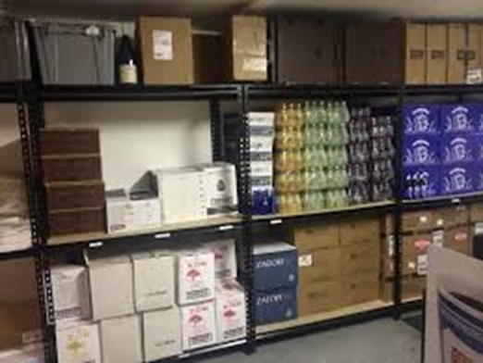
Storing Dry Goods and Supplies
Keep the dry goods storeroom clean, dry and follow safe food storage practices.
Label food with Month/Date/Year received, Example: 12/8/20
Rotate using FIFO (First In, First Out)
Leave space to provide air circulation
Store food and paper goods separate from chemicals
Food and supplies should be stored away from walls and at least 6 inches off the floor
Notes:
TELL: Food should be stored properly and used in a timely manner to ensure quality and safety. Poor storage practices can cause food to spoil quickly with potentially serious results – such as a foodborne illness outbreak. Keep all storage areas and equipment clean and dry, label packaging with the date it was received (date/month/year), rotate products to ensure that the oldest inventory is used first (first in, first out). Store food and supplies away from walls and at least six inches off the floor in the designated storage area and away from chemicals. Remember to keep all TCS (temperature control for safety) food out of the temperature danger zone 41⁰F-135⁰F.
Next Slide

Slide 13
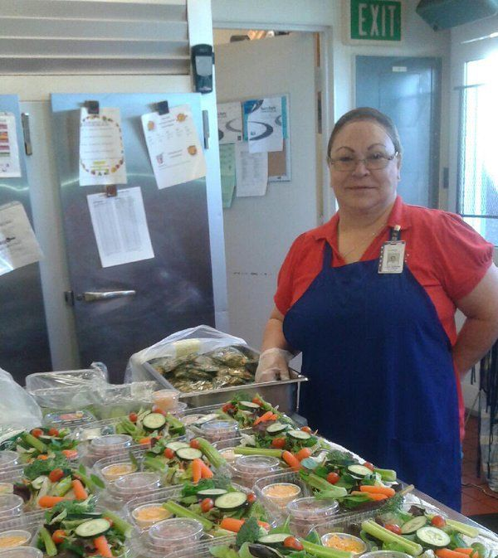
Preparation
Prepare food on clean and sanitize workstations, using clean cutting boards and utensils.
Prevent time-temperature abuse:
Only remove as much food from the cooler as you can prep in a short period of time
Return prepped food to the cooler or cook it as quickly as possible
Notes:
TELL: Food prepared in large volumes or in advance for next day service usually follow an extended process flow. These foods pass through the temperature danger zone more than one time; thus, the potential for the growth of bacteria is greater during this process. Failure to adequately control food product temperatures is one of the most frequently encountered risk factors contributing to foodborne illness.
Next Slide

Slide 14
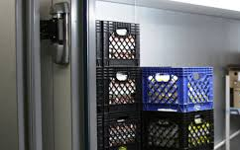
Storing Cold Prepared Food
All prepared cold food items must remain in a refrigerator holding unit until ready for cooking or service.
Food must be kept cold at 41° or lower
Notes:
TELL: All prepared food items that are not used for same day service must remain in the refrigerator holding unit until ready for cooking. In order to keep food items at the safe level, it must be kept refrigerated at 41° or lower. After the food have been heated to the correct temperature, food must be kept in the Hot Holding Food Cabinet at least 135° or above to keep it safe.
Next Slide

Slide 15
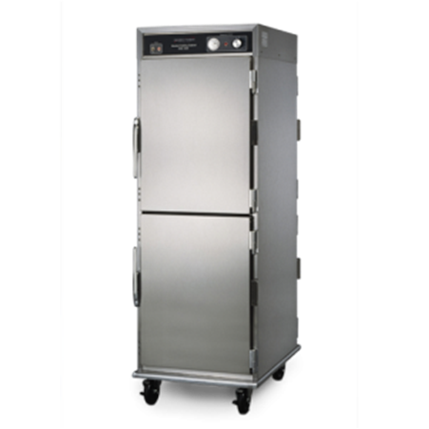
Storing Hot Prepared Food
After cooking, hot food must be placed inside a hot holding food cabinet until ready to be served.
Hot food must be kept at a temperature of 135° or above
Notes:
TELL: All prepared food items that are not used for same day service must remain in the refrigerator holding unit until ready for cooking. In order to keep food items at the safe level, it must be kept refrigerated at 41° or lower. After the food have been heated to the correct temperature, food must be kept in the Hot Holding Food Cabinet at least 135° or above to keep it safe.
Next Slide

Slide 16
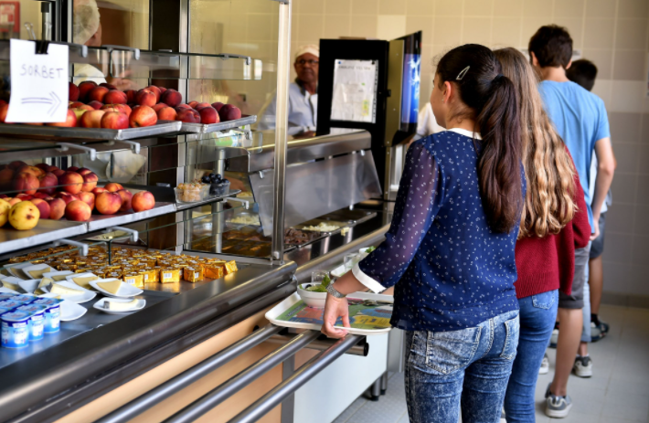
Serving
Foods must be at the proper temperature before they are served to customers.
Record temperatures on the Food Temperature Log
Corrective actions must be taken when temperatures fall into the temperature danger zone
Reheat the food item to 165° for 15 seconds
Discard if necessary
Notes:
TELL: Meals should be ready to serve at least five minutes before lunch. Take the temperature of the food item(s) and must be recorded on the Food Temperature Log. Identify the menu item(s) and record the temperature. At any time the food is deemed unsafe during service, corrective action must be taken. Reheat food item to 165° and must be held for at least 15 seconds.
Next Slide

Slide 17
HACCP Plan Topics
Personal Hygiene
Food Safety Training
An effective HACCP plan includes detailed systems in the following areas:
Facilities
HACCP Plan Topics
Cleaning and Sanitation
Supplier Control
Receiving and Storing
Notes:
TELL: HACCP is a written plan that defines the procedures for maintaining control of potentially hazardous food at a critical control point of food preparation or processing. It is a plan stating how food is to be handled so consumers do not get sick. The following topics must be included in a HACCP plan: personal hygiene, facility, supplier control, receiving and storage, cleaning and sanitation of equipment, and food safety training.
These topics are individually addressed in the daily operational practices which are the SOP’s.
Next Slide

Slide 18
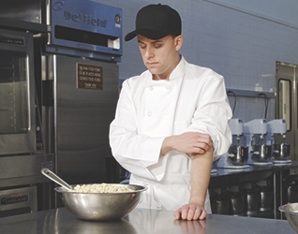
Personal Hygiene
Implement an employee personal hygiene program that prevents the spread of bacteria, parasites, and viruses.
Establish the following protocols:
Proper handwashing procedures
Eliminate all bare hand contact with food
Exclusion and restriction of ill employees
Notes:
TELL: When employees work with food and food-contact surfaces, they can easily spread bacteria parasites, and viruses. Managing personal hygiene is important to controlling these hazards. It is recommended that a management program for employee personal hygiene be implemented that addresses the procedures for proper handwashing, the appropriate use of gloves and dispensing utensils, control of bare hand contact with ready-to-eat foods, and the exclusion and restriction of ill employees. Proper handwashing includes scrubbing hands and arms for 10-15 seconds, then rinsing, the total process should take 20 seconds; keep nails short and clean use hand sink for washing hands.
Next Slide

Slide 19
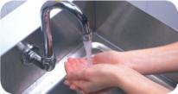
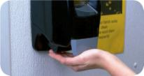
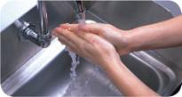
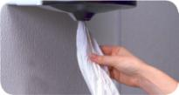
Proper Hand Washing Procedure
How to wash hands (should take at least 20 seconds):
1. Wet hands and arms. Use running water as hot as you can comfortably stand. It should be at least 100°F(38°C).
2. Apply soap. Apply enough to build up a good lather.
3. Scrub hands and arms vigorously. Scrub them for 10 to 15 seconds. Clean under fingernails and between fingers.
4. Rinse hands and arms thoroughly. Use running warm water.
5. Dry hands and arms. Use a single-use paper towel or hand dryer. Consider using a paper towel to turn off the faucet and open the restroom door.
Notes:
TELL: It is very important to wash your hands before starting a new task. Start by wetting your hands with running hot water 100°, then apply the soap. Scrub hands and arms vigorously for 10 to 15 seconds, also clean under fingernails and between fingers. Rinse your hands thoroughly afterward. Then use only a disposable/single use towel to dry your hands. The preferred method of drying hands is an air dyer if available. To avoid re-contaminating your hands use a paper towel to open the door, hold the door open with your foot or elbow and then discard the paper towel in the trash can. Handwashing is one of the best preventative measures against biological hazard.
NOTE: Safety and Sanitation Policies requires food service staff to re-wash your hands each time they begin a new task in the kitchen.
Next Slide

Slide 20
Facilities
Evaluate every aspect of the operation and follow up with necessary corrective actions.
Routine self inspection
Potential kitchen hazards
HACCP logs accurately completed
Effectiveness of employee training
Health department inspection report
Pest Management System reports
Notes:
TELL: Food Services must adhere to the California Food Code, 3-201.11 that states, “All supplies must be inspected to ensure they are safe to use before accepting” and "Suppliers must deliver food when staff has ample time to do inspections.”
Next Slide

Slide 21
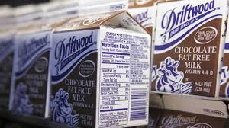
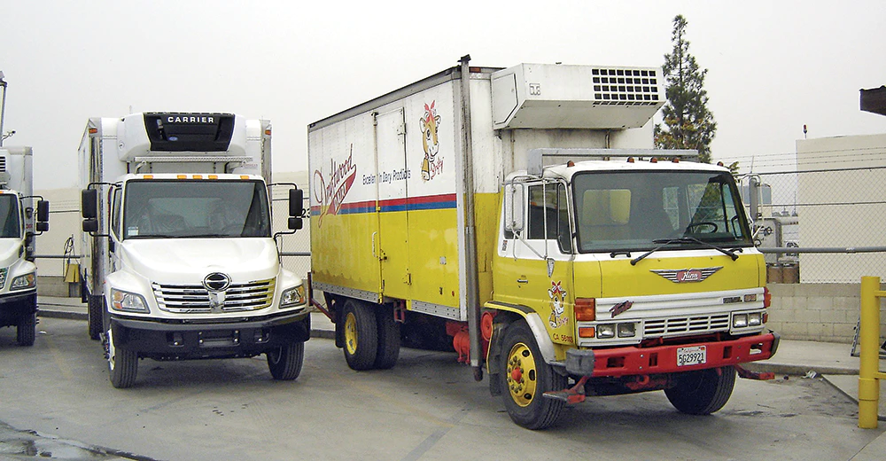
Supplier Control
Purchase food from approved, reputable suppliers that:
Have been inspected
Meet all applicable local, state and federal laws
Have an implemented HACCP plan
Follow food safety practices when transporting food
Notes:
TELL: Food Services must adhere to the California Food Code, 3-201.11 that states, “All supplies must be inspected to ensure they are safe to use before accepting” and "Suppliers must deliver food when staff has ample time to do inspections.”
Next Slide

Slide 22
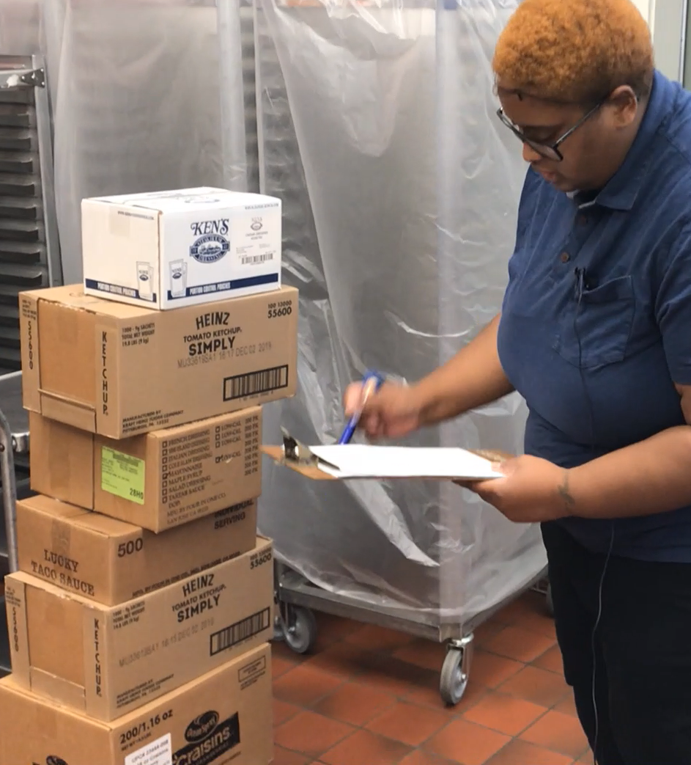
Receiving and Storing Practices
When receiving supplies:
Food items must be stored in dry storage or refrigeration
Label all product with month/day/year
Follow FIFO to ensure freshness
Notes:
TELL: Part of the HACCP plan when receiving and storing is to check the temperature of the food. Have a calibrated thermometer available for inspection. Check the delivery truck for any signs of contamination, such as pests or water marks from frozen food, check all items delivered for signs of temperature abuse (ice crystals, wet boxes, etc) and if found decline the delivery. Food items must be stored away as quickly as possible to prevent thawing.
Next Slide

Slide 23
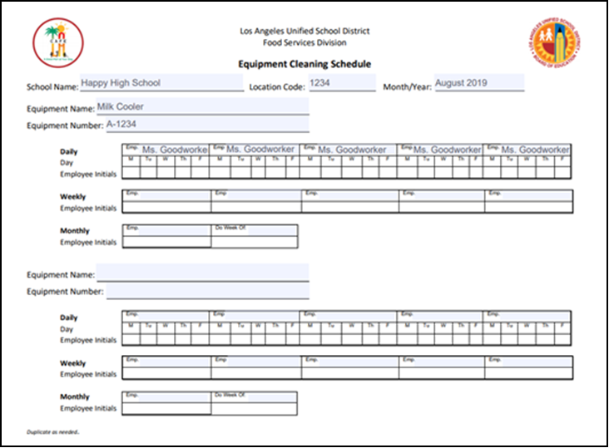
Cleaning and Sanitizing
Ensure all equipment is clean and sanitized by implementing a cleaning schedule.
Post a master cleaning schedule that identifies:
Equipment to be cleaned
Who will clean the equipment
Rotate staff cleaning assignments.
Notes:
TELL: A master cleaning schedule must be posted at all time. This schedule will indicate who is in charge of cleaning specific equipment. Supervisors will develop the schedule based on the menu. Remember all electrical equipment must be unplugged from any electrical outlet. This must be the first step in cleaning. Keeping your facility clean and sanitary will help prevent food from becoming contaminated and will also keep pests from thriving in your facility.
Next Slide

Slide 24
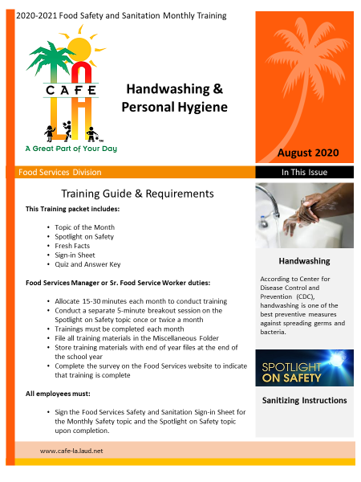
Food Safety Training
Managers are responsible for providing food safety training to all staff.
Monthly Safety and Sanitation
Pre-shift meetings
Food safety updates
Notes:
TELL: It is the supervisor/manager’s responsibility to train all staff to comply with the FDA regulatory guideline. The FDA oversees that all food is grown, processed, transported, delivered, prepared and served safely to all consumers.
Example: At the Chipotle Mexican Grill, an outbreak of Norovirus in Simi Valley in January of 2016, which affected 234 customers with the symptom of diarrhea and vomiting. Chipotle’s corrective action was to close the restaurant and do a full training of their employees on how to wash hands and use protective gloves when prepping. This is why we need to adhere to the HACCP plan..
Next Slide

Slide 25
Food Safety Certification
All designated staff listed below are required to have an approved and accredited food safety certification certificate.
Food Service Managers
Senior Food Service Workers
Food Service Worker II
Certificates must be current and renewed every 5 years.
Notes:
TELL: Food Services Division requires that all managers, assistant managers/ senior workers and drivers are to have a ServSafe Certificate that must be renewed every five years. Here is an example of a ServSafe Certificate. This certificate ensures that our Food Services employees are knowledgeable to keep the food safe from all contaminations.
Next Slide

Slide 26
The 7 HACCP Principles
To have a systematic approach, food service operations implement the 7 HACCP principles outlined here to prevent food borne illness.
1. Conduct Hazard Analysis
2. Identify Critical Control Points
3. Establish Critical Limits
4. Identify Corrective Action Procedures
5. Monitoring Procedures
6. Verify the System Works
7. Establish Record Keeping
Notes:
TELL: A HACCP plan is based on the seven basic principles outlined by the National Advisory Committee on Microbiological Criteria
for Food. These principles are seven sequential steps that outline how to create a HACCP plan. In general terms, principles 1 and 2
identify and evaluate the hazards. Principles 3, 4, and 5, establish ways for controlling those hazards. Principles 6 and 7, maintain the
HACCP plan and system and verify its effectiveness. Maintaining an effective HACCP system depends largely on regularly
scheduled verification activities. The HACCP plan should be updated and revised as needed. An important aspect of maintaining the
HACCP system is to assure that all individuals involved are properly trained so they understand their role and can effectively fulfill
their responsibilities.
Next Slide

Slide 27
Step 1 - Conduct a Hazard Analysis
To eliminate or reduce potential hazardous food to a safe level, critical limits are identified during the hazard analysis phase.
Review menus 24-48 hours in advance
Identify all potentially hazardous foods
Identify where and how food may become contaminated
Plan for control measures
Notes:
TELL: Step One is to conduct a Hazard Analysis to identify and assess potential hazards in the food you serve, start by taking a look at how it is processed in your facility. You should review menus 24-48 hours in advance. Some food items are prepared and cooked for the same-day service such as hamburgers and chicken, and some foods are served without cooking such as salads and cold sandwiches. In this case, we are preparing food for delivery to schools. There is no need for cooking or heating. All food delivered must be at a temperature below 41° or lower. You should be planning for control measures.
Next Slide

Slide 28
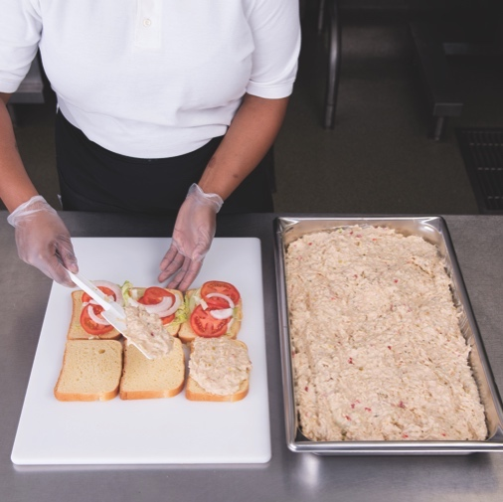
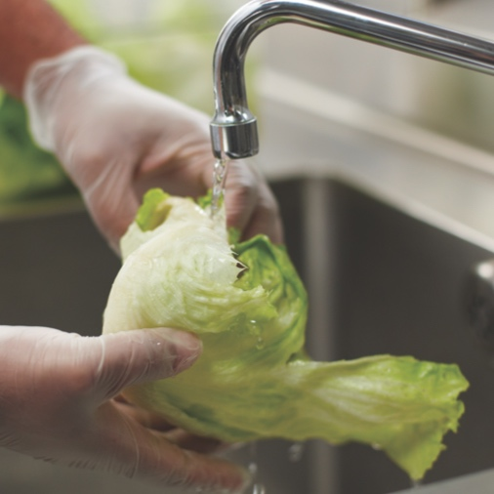
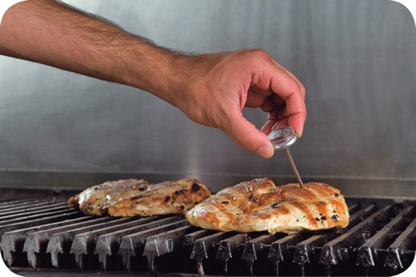
STEP 2 – Identifying CCP’s
Critical Control Points (CCP) are steps throughout the flow of food where possible food safety hazards are identified.
Examples:
Receiving
Storing
Cooking food
Serving Food
Notes:
TELL: Step 2 is to identify the critical control points. Let’s Continue using the Chef Salad recipe, the CCP should always be listed as part of the process. The CCP for the Chef Salad has determined that there is a bacterial risk to the hard boiled eggs, turkey ham, and cheese during salad preparation. Staff must hold the salad at a temperature at 41° or lower until shipping time in order to prevent the bacterial growth.
Next Slide

Slide 29
Step 3 - Establish Critical Limits
Critical limits are established to eliminate or reduce potential hazardous food to a safe level.
Example 1: Chef salad should be held at 41° or below
Example 2: Cooked macaroni for chili mac must be cooled to 41° or below
Notes:
TELL: Step 3 is to establish critical limits for each critical control point that must be met to prevent or eliminate the hazard, or to reduce it to a safe level. Examples shown are Chef Salad and Chili Mac. Once the Chef Salads have been prepared, it must be refrigerated at 41° or below. When preparing the Chili Mac, the recipe states that once the macaroni has been cooked, it must be cooled down to 41° or below before mixing the remaining ingredients.
Note: All Food Services recipes include HACCP instructions for review.
Next Slide

Slide 30
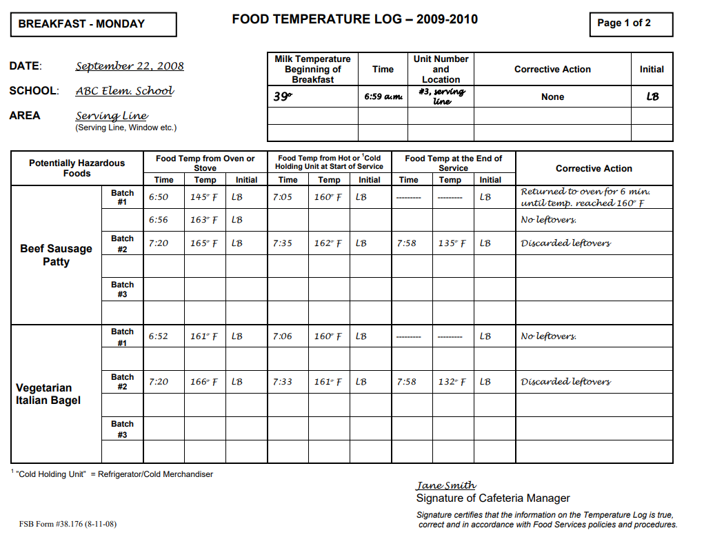
Step 4 – Monitoring Procedures
Establish a process to monitor food temperatures throughout the cooking and holding of food items.
Take the internal temperature of the potential hazardous food
Assign staff to document food temperatures
Use clean and sanitized thermometer
Log temperature on the food temperature log
Monitor temperatures during holding
Notes:
TELL: Step 4 of the HAACP plan is to determine the best way to monitor the food so that the critical control points are consistently met. Identify who will monitor the critical control points and how often. To monitor cold food, insert a clean, sanitized thermometer into the cold salad (ie Chef Salad, hard boiled egg). Wait for 15 seconds for the thermometer to steady for accurate reading. Document the internal temperature on the food temperature log.
Next Slide

Slide 31
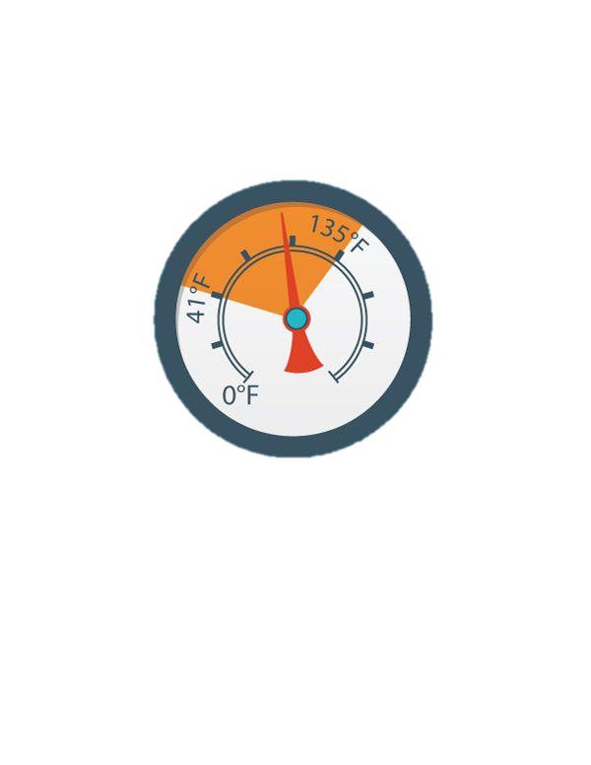
Step 5 - Identify Corrective Actions
Determine in advance what corrective actions will be taken when a critical limit is not met.
If the temperature of cold salad is higher than 41°F, the corrective action is to place the salad in the refrigeration immediately
Corrective actions must be documented on the food temperature log
Notes:
TELL: Step 5 is to Identify all corrective actions that must be taking when a critical limit is not met. These steps should be determined in advance. During cold storage holding if the temperature of the salad is higher than 41º F, it must be placed back under refrigeration and cooled until it reaches 41ºF or lower before transport. Document the food temperature and the corrective actions on food temperature log.
Next Slide

Slide 32
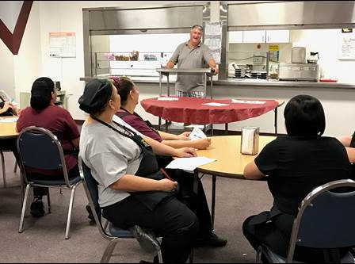
Step 6 - Verify that the System Works
Determine if the HACCP plan is working
Evaluate your facility’s HACCP Logs daily
Retrain staff as needed
Revise Standard Operating Procedures if applicable
Notes:
TELL: Step 6 is to determine if the HACCP plan is working as intended for your facility. Ask yourself this question? Does your action help prevent, reduce or eliminate hazards? Evaluate all logs daily to ensure that critical limits were met and or appropriate corrective actions were taken when necessary. Retrain your staff if they are not following food safety procedures correctly.
Next Slide

Slide 33
Step 7 - Establish Record Keeping
The following logs are tools used to ensure that HACCP procedures are taking place:
Damaged or Discarded Log
Equipment Cleaning Schedule Log
Food Temperature Log
Refrigerator and Freezer Temperature Log
Thermometers Calibration Log
Pest Control Inspection Log
Notes:
TELL: Step 7 is to establish a record keeping procedure. All logs must be maintained, accurately completed, and filed daily. Record keeping is a very important part of HACCP compliance. LA County Health Inspectors and State Auditors can pull and review all documents. Make sure all staff is trained on proper use of the logs.
Next Slide

Slide 34
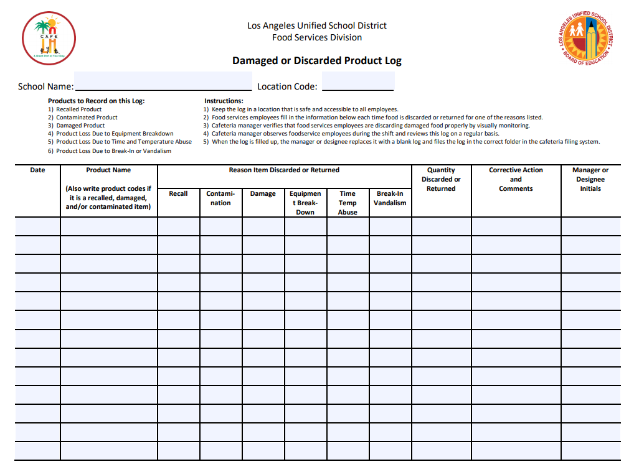
Damaged or Discarded Product Log
Damaged or Discard Product Logs are used to document and track food products due to the following reasons:
Damaged
Recalled
Discarded due to quality
Expired
Notes:
TELL: The Damaged or Discarded Product Log is used to document any products that are damaged, recalled, or to be discarded because of quality issues. The Quality Control employee will follow the steps to complete the log. First, complete the heading, for example, NNC. Enter the date of the products to be discarded. Write in the product name and its code. Place a check mark inside the box for the reason, such as recall, contamination, damage, etc. Document how many cases, bags, or boxes. Write in the corrective action and comments. And finally the manager or designee will initial the log to complete the action taken.
Next Slide

Slide 35
Damaged or Discarded Product Log
Complete the log with:
Header
Date
Product name
Reason for discard
Quantity
Corrective action
Manager initial
A
B
C
D
E
F
G
Enter discarded items on the CMS Production Record including the reason code to indicate the item was removed from inventory.
Notes:
TELL: The Damaged or Discarded Product Log is used to document any products that are damaged, recalled, or to be discarded because of quality issues. The Quality Control employee will follow the steps to complete the log. First, complete the heading, for example, NNC. Enter the date of the products to be discarded. Write in the product name and its code. Place a check mark inside the box for the reason, such as recall, contamination, damage, etc. Document how many cases, bags, or boxes. Write in the corrective action and comments. And finally the manager or designee will initial the log to complete the action taken.
Next Slide

Slide 36
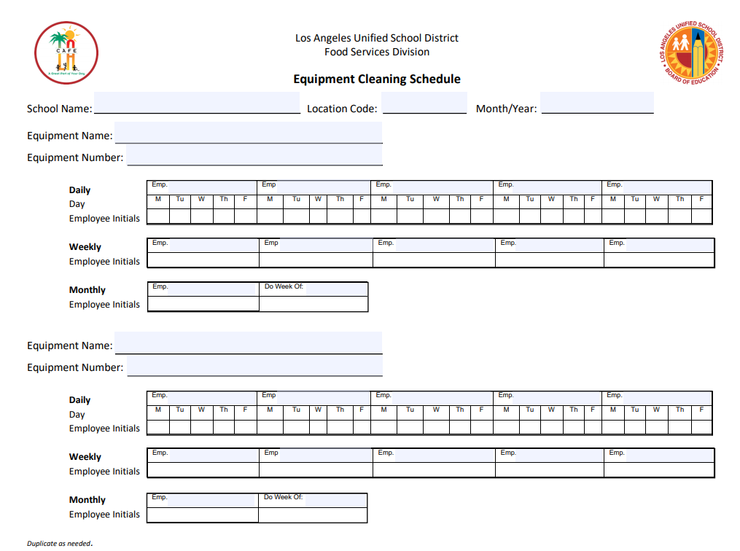
Equipment Cleaning Schedule
The Equipment Cleaning Schedule is a tool used by managers to ensure all equipment is cleaned regularly.
Staff is assigned and responsible for cleaning and sanitizing daily, weekly, or monthly.
Staff will write their initials on the form after the task has been completed.
Notes:
TELL: There must be an Equipment Cleaning Schedules conveniently located throughout the NNC for all production equipment lines. The schedule must be maintained daily, weekly, and monthly. As shown, each person is assigned to equipment and is responsible for cleaning and sanitizing. All equipment and utensils used must be cleaned and sanitize between each uses. Staff must write in their initials on the form the day the cleaning was completed.
Next Slide
.

Slide 37
Equipment Cleaning Schedule Instructions
Complete the log with:
Header
Equipment name
Equipment number
Cleaning frequency
Daily
Weekly
Monthly
A
B
C
D
Each piece of equipment will have its own section on the log. Managers will assign the daily, weekly and monthly tasks.
Notes:
TELL: The Damaged or Discarded Product Log is used to document any products that are damaged, recalled, or to be discarded because of quality issues. The Quality Control employee will follow the steps to complete the log. First, complete the heading, for example, NNC. Enter the date of the products to be discarded. Write in the product name and its code. Place a check mark inside the box for the reason, such as recall, contamination, damage, etc. Document how many cases, bags, or boxes. Write in the corrective action and comments. And finally the manager or designee will initial the log to complete the action taken.
Next Slide

Slide 38
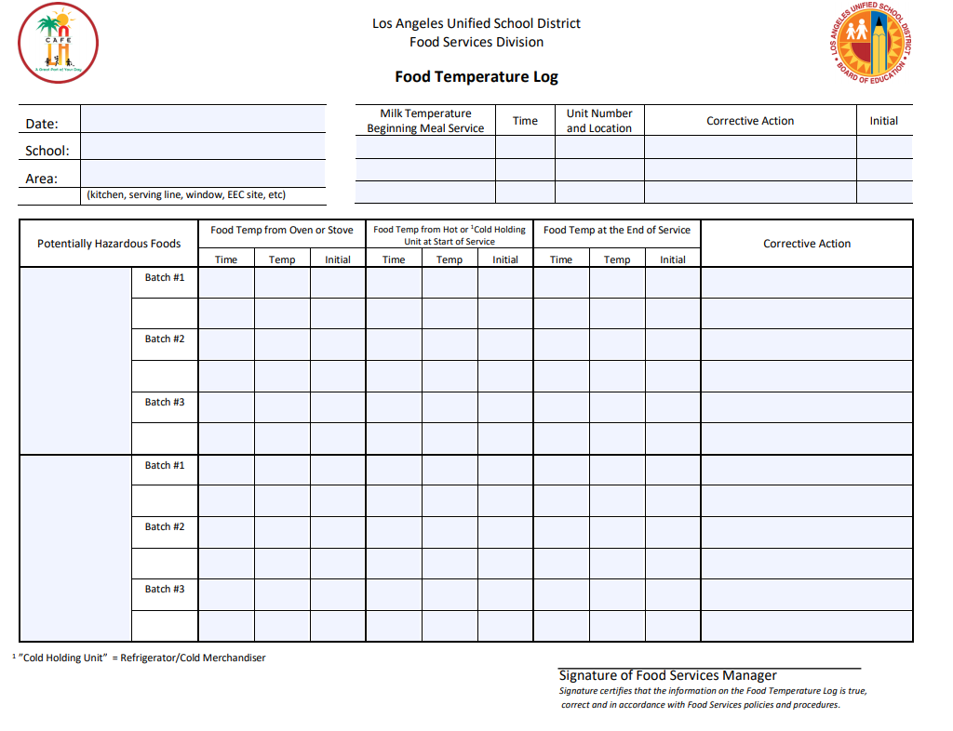
Food Temperature Log
The Food Temperature Log is used to ensure safe food temperatures throughout the cooking and holding of potentially hazardous food items.
Temperatures are recorded:
After cooking
During hot holding stages
At end of service
Milk at beginning of meal service
X
Notes:
TELL: Each production line must have a food temperature log that is monitored throughout the day. This log illustrates the time and temperature of the food. This log must be initialed by the monitor.
NEXT SLIDE

Slide 39
Food Temperature Log Instructions
Complete the log with:
Header
Milk temperature at the beginning of meal service
Temperature
Time
Unit # and location
Corrective action (if needed)
A
B
C
D
E
F
G
Notes:
TELL: The Damaged or Discarded Product Log is used to document any products that are damaged, recalled, or to be discarded because of quality issues. The Quality Control employee will follow the steps to complete the log. First, complete the heading, for example, NNC. Enter the date of the products to be discarded. Write in the product name and its code. Place a check mark inside the box for the reason, such as recall, contamination, damage, etc. Document how many cases, bags, or boxes. Write in the corrective action and comments. And finally the manager or designee will initial the log to complete the action taken.
Next Slide

Slide 40
Food Temperature Log Instructions continued
Complete the log with:
Name of potentially hazardous food
Food temp from oven or stove
Time removed
Temp when removed
Worker initial
Food temp from hot or cold holding at the start of service
Time of start of service
Temp at start of service
Worker initial
A
B
C
D
E
F
G
Notes:
TELL: The Damaged or Discarded Product Log is used to document any products that are damaged, recalled, or to be discarded because of quality issues. The Quality Control employee will follow the steps to complete the log. First, complete the heading, for example, NNC. Enter the date of the products to be discarded. Write in the product name and its code. Place a check mark inside the box for the reason, such as recall, contamination, damage, etc. Document how many cases, bags, or boxes. Write in the corrective action and comments. And finally the manager or designee will initial the log to complete the action taken.
Next Slide

Slide 41
Food Temperature Log Instructions continued
Complete the log with:
F. Food temped at the end of service
Time food removed from service
Temp when removed
Worker initial
G. Corrective action if necessary
Take and record corrective actions if temperature does not fall withing range indicated on the recipe
A
B
C
D
E
F
G
Notes:
TELL: The Damaged or Discarded Product Log is used to document any products that are damaged, recalled, or to be discarded because of quality issues. The Quality Control employee will follow the steps to complete the log. First, complete the heading, for example, NNC. Enter the date of the products to be discarded. Write in the product name and its code. Place a check mark inside the box for the reason, such as recall, contamination, damage, etc. Document how many cases, bags, or boxes. Write in the corrective action and comments. And finally the manager or designee will initial the log to complete the action taken.
Next Slide

Slide 42
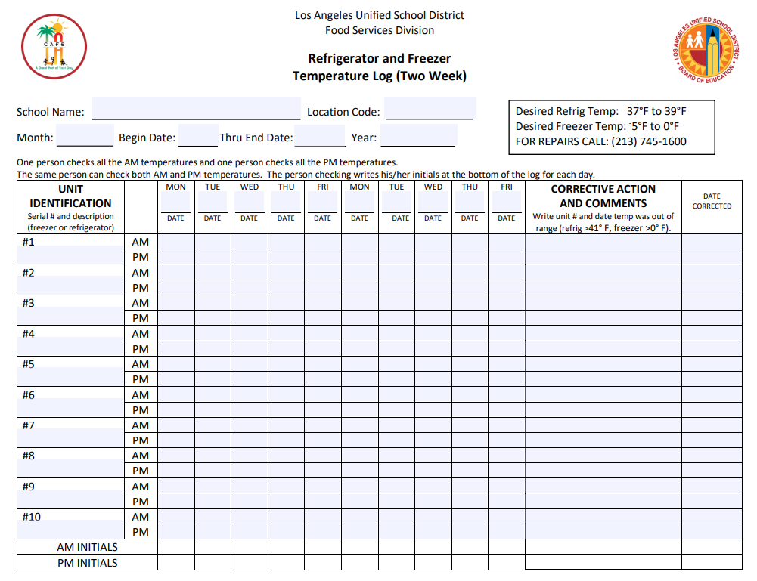
Refrigerator/Freezer Temperature Log
“Refrigerator and Freezer Temperature Log” is used to ensure equipment is in proper working order and potentially hazardous foods are stored at:
41ºF or lower in refrigerators
0ºF or below in freezers
The logs are used on a two-week cycle.
Notes:
TELL: Refrigeration storage is used to hold potentially hazardous food at 41ºF or lower. Freezers should be kept at 0ºF or below to make sure the food items inside will freeze. It is important to monitor the temperature of both the refrigerators and freezers on a regular basis. Food exposed to temperatures in the danger zone can potentially cause a growth of microorganisms at levels high enough to cause illness.
Next Slide

Slide 43
Equipment Cleaning Schedule Instructions
Complete the log with:
Header
Date
Equipment name
Unit #
Freezer or refrigerator
AM and PM temperature on corresponding line
A
B
C
D
E
F
Notes:
TELL: The Damaged or Discarded Product Log is used to document any products that are damaged, recalled, or to be discarded because of quality issues. The Quality Control employee will follow the steps to complete the log. First, complete the heading, for example, NNC. Enter the date of the products to be discarded. Write in the product name and its code. Place a check mark inside the box for the reason, such as recall, contamination, damage, etc. Document how many cases, bags, or boxes. Write in the corrective action and comments. And finally the manager or designee will initial the log to complete the action taken.
Next Slide

Slide 44
Equipment Cleaning Schedule Instructions continued
Complete the log with:
E. Corrective Actions as needed if temperature is above 41ºF and date corrected
F. Initials of worker who recorded temperature
A
B
C
D
E
F
Refrigerator and freezer temperature log sheets are used for 2 weeks then filed.
Notes:
TELL: The Damaged or Discarded Product Log is used to document any products that are damaged, recalled, or to be discarded because of quality issues. The Quality Control employee will follow the steps to complete the log. First, complete the heading, for example, NNC. Enter the date of the products to be discarded. Write in the product name and its code. Place a check mark inside the box for the reason, such as recall, contamination, damage, etc. Document how many cases, bags, or boxes. Write in the corrective action and comments. And finally the manager or designee will initial the log to complete the action taken.
Next Slide

Slide 45
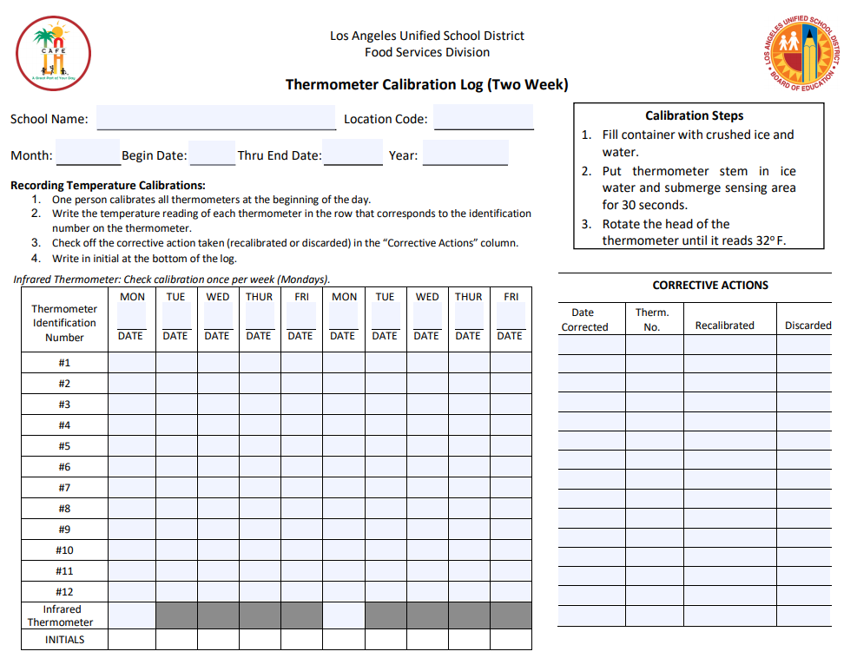
Thermometer Calibration Log
“Thermometer Calibration Log” verifies all thermometers in the cafeteria are calibrated to accurately register temperatures taken.
Use ice point method
Completed daily
Recalibrate or discard thermometers as needed
Notes:
TELL: The Thermometer Calibration Log is a bi-weekly form, and needs to be completed daily. In the header section, fill in the school or location name, location code, and month; beginning and ending date and year. If the thermometer does not hold the correct temperature when calibrating, discard the thermometer and replace it with a new one. When replaced, identify the thermometer with the same number. All corrective action must be noted on the form. Date of the corrective action to identify the thermometer and check if calibrated or discarded.

Slide 46
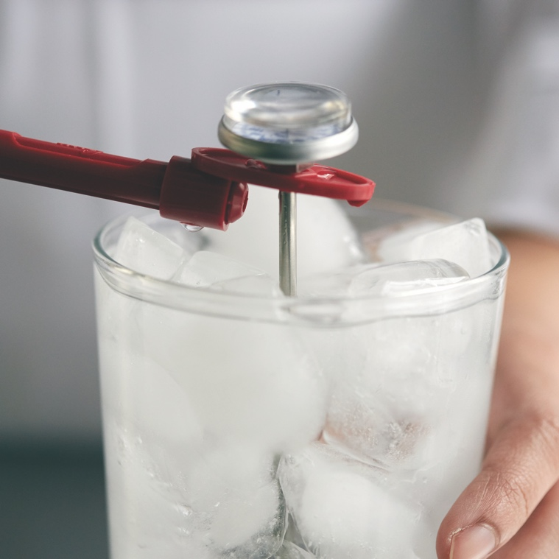
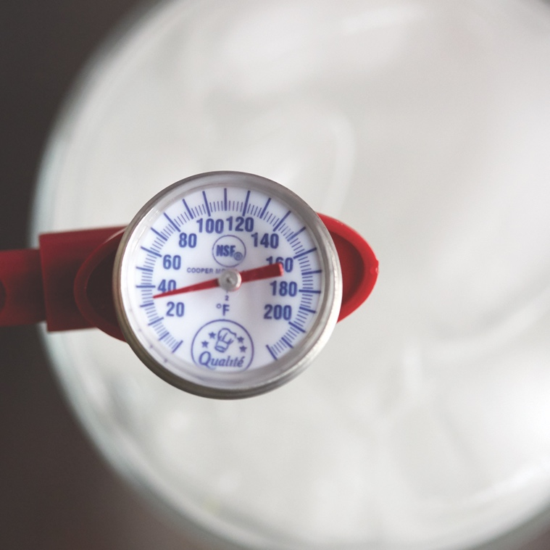
Calibration Using Ice Point Method
Bi-metallic thermometers are common in out kitchens but can easily become out of calibration. They must be calibrated:
If they have been bumped or dropped
If they have been exposed to extreme temperature changes
Before each shift
Calibrate Thermometers using the ice point method
1. Fill a container with ice, and add tap water.
2. Submerge the sensing area and wait 30 seconds.
3. Adjust the thermometer so it reads 32ºF (0ºC).
Notes:
TELL: The Thermometer Calibration Log is a bi-weekly form, and needs to be completed daily. In the header section, fill in the school or location name, location code, and month; beginning and ending date and year. If the thermometer does not hold the correct temperature when calibrating, discard the thermometer and replace it with a new one. When replaced, identify the thermometer with the same number. All corrective action must be noted on the form. Date of the corrective action to identify the thermometer and check if calibrated or discarded.

Slide 47
Thermometer Calibration Log Instructions
Complete the log with:
A. Header
Date
Record the temperature of the corresponding thermometer using the ice point method
Check off the corrective action taken (recalibrated or discarded) in the “Corrective Actions” column
Initial the bottom of log
A
B
C
D
E
Thermometer Calibration Logs are used for 2 weeks then filed.
Notes:
TELL: The Damaged or Discarded Product Log is used to document any products that are damaged, recalled, or to be discarded because of quality issues. The Quality Control employee will follow the steps to complete the log. First, complete the heading, for example, NNC. Enter the date of the products to be discarded. Write in the product name and its code. Place a check mark inside the box for the reason, such as recall, contamination, damage, etc. Document how many cases, bags, or boxes. Write in the corrective action and comments. And finally the manager or designee will initial the log to complete the action taken.
Next Slide

Slide 48
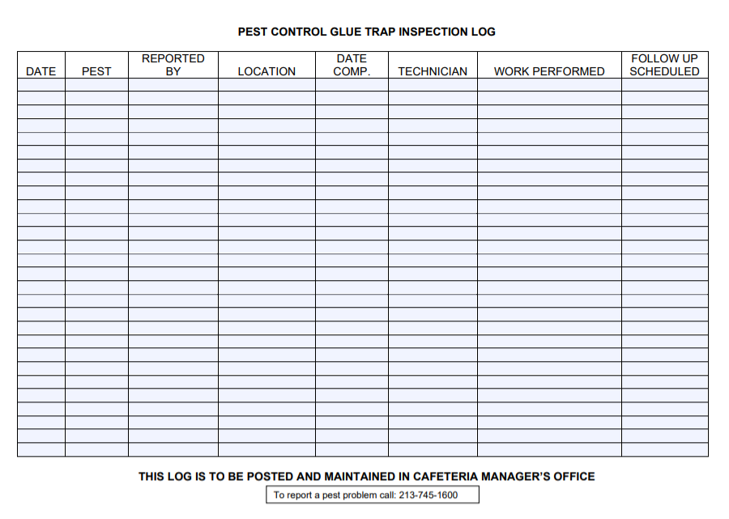
Pest Control Inspection Log
“Pest Control Inspection Log” is used by the manager and pest control to communicate pest sightings and work performed.
Posted and maintained in cafeteria managers office
Record the date, location, and who reported the sighting.
Notes:
TELL: The Thermometer Calibration Log is a bi-weekly form, and needs to be completed daily. In the header section, fill in the school or location name, location code, and month; beginning and ending date and year. If the thermometer does not hold the correct temperature when calibrating, discard the thermometer and replace it with a new one. When replaced, identify the thermometer with the same number. All corrective action must be noted on the form. Date of the corrective action to identify the thermometer and check if calibrated or discarded.

Slide 49
Pest Control Inspection Log
Complete the log with:
A. Date
Pest sighted
Who reported the sighting
Location of pest
Filled in by pest control
A
B
C
D
E
Notes:
TELL: The Damaged or Discarded Product Log is used to document any products that are damaged, recalled, or to be discarded because of quality issues. The Quality Control employee will follow the steps to complete the log. First, complete the heading, for example, NNC. Enter the date of the products to be discarded. Write in the product name and its code. Place a check mark inside the box for the reason, such as recall, contamination, damage, etc. Document how many cases, bags, or boxes. Write in the corrective action and comments. And finally the manager or designee will initial the log to complete the action taken.
Next Slide

Slide 50
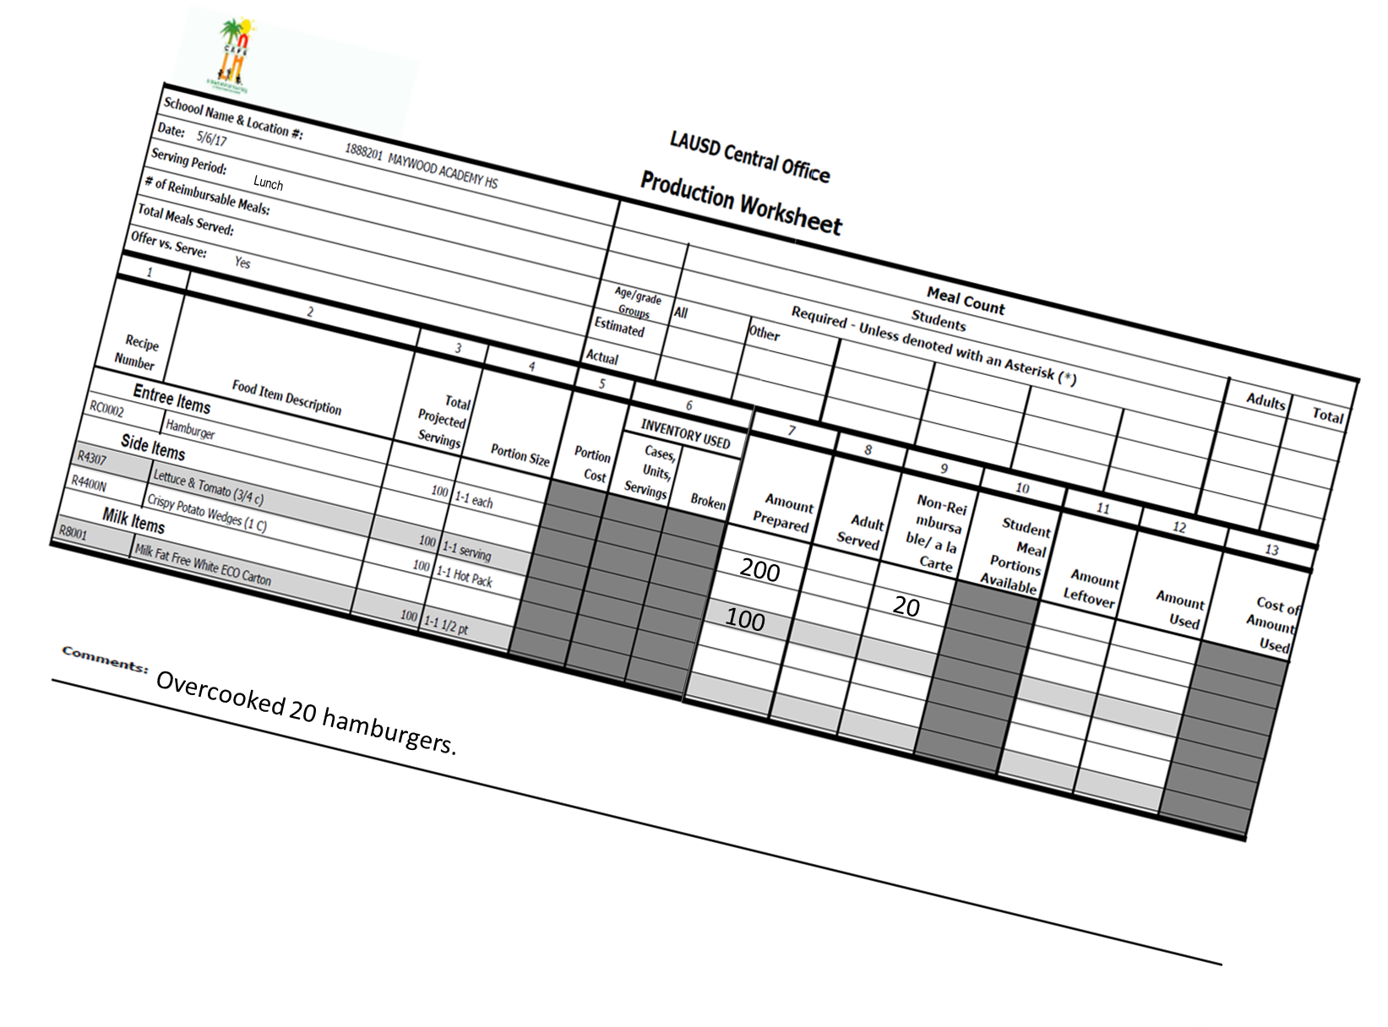
Record Keeping Requirements
As required by the Food Services Division to meet both Federal and State laws, these records must be kept for three years plus current year.
Local agencies must verify all records during health inspections.
2
HACCP LOGS
xxxxxxxxxxxxxxxxxxxxxxxxxxxxxxxxxxxxxxxxxxxxxxxxxxxxxxxxxxxxxxxxx
Notes:
TELL: The Food Services Division requires that temperature logs and calibration logs must be kept for 2 years plus the current year to meet both Federal and State regulations. Local agencies must verify all records during Inspections.
Next Slide

Slide 51
Questions?
Thank you!
LAUSD Food Services Division
Nourishing Children to Achieve Excellence
Notes:
Tell: This concludes the NNC HACCP training, at this time I will be happy to answer questions.

